Slide 1
Distance

Slide 2
Distance in 1 Dimension
What is missing from this game?
How will the computer know when the characters have collided?
Open your Game file, and scroll down until you see the definition of _distances-color_.
Change the value from “” to a color that will show up on your background, and click Run.
Notes:
This setting will draw lines from your Player to each of the other characters, and then use those lines as the hypotenuse of right triangles!
The legs of these triangles show the distance in 1 dimension each (on the x- and y-axis). How is this calculated?

Slide 3



Distance in 1 Dimension
600 - 200
cx - px
cx comes first, because it’s larger...
Notes:
Role-Play: Ask a volunteer to help role-play two characters colliding!
Identify a "number line" on the floor (this can be done just by pointing, or with a visual aid).
Make sure that you and your volunteer stand with feet as close together as possible, representing the infinitely small point that identifies your center. Raise your arms to form a "T shape", representing the outer edges of the characters.
Emphasize that this represents one dimension (perhaps the x- or y-axis), or one “Number line”.
With the volunteer, stand about 10 steps away from one another and side-step towards each other one step at a time, while asking the class, "True or False? We are colliding!" Be sure to only accept "true" and "false" as responses - not "yes" and "no"!
Ask the class how far apart you and your volunteer are, and then ask them how they would calculate this if you were standing on a number line and they could see the actual coordinates under your feet.

Slide 4
Distance in 1 Dimension
600 - 200
px - cx
That’s not the same order as before! Now px is larger!
Notes:
After a few iterations, try switching places and repeating. Point out that students always subtract the smaller number from the larger one, regardless of the character order!
Do this until students can clearly see it’s when the two characters are 'touching' or 'overlapping' in some way - NOT when they are 'at the same point.'

Slide 5

Distance in 1 Dimension
# line-length : Number Number -> Number
# distance between 2 points on a number line
examples:
line-length(20, 10) is (20 - 10))
line-length 10 20) is (20 - 10))
end
fun line-length(a, b):
if a > b: a - b
else: b - a
end
end
In your own words, what does this function do?
How does it work?
Why does it use conditionals?
Notes:
Have students open their game files and scroll to find this function. Then have them click “Run”, and practice using the line-length function in the Interactions area with different values for ‘a’ and ‘b’.

Slide 6
Distance in 1 Dimension
line-length computes the positive distance between two points on a single number line.
If two coordinates differ by their x-values, this function will tell us how far apart they are.
If two coordinates differ by their y-values, this function will tell us how far apart they are.
But what if the coordinates differ by both x and y...?

Slide 7
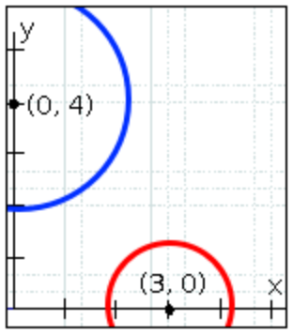
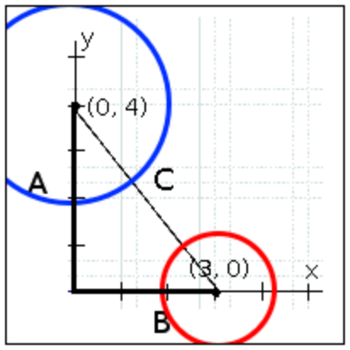
Distance in 2 Dimensions
How do we know when these circles are touching?
If we drew a straight line between these two points, that would represent the distance between them.
The circles touch when the sum of their radii is less than the distance.

Slide 8
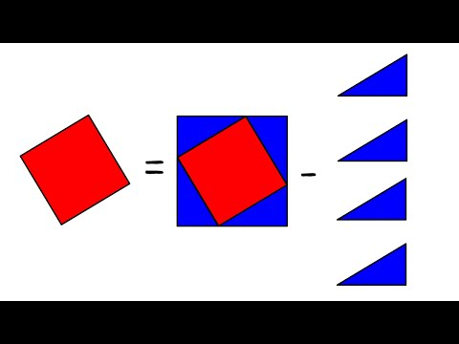
Distance in 2 Dimensions
Click on the image to watch this 4-minute video.
What questions do you have?
Notes:
Video Credit: Tova Brown

Slide 9
Distance in 2 Dimensions
Turn to The Distance Between (0,2) and (4,5) in your workbooks.
Convert this expression to a Circle of Evaluation, then code.
Use the Design Recipe to write distance, which computes the distance between any two points! HINT: the code you wrote on the previous page can be used as your first example!
In your game, fix the distance function. How do you know whether or not it works?
Notes:
It is extremely common for students to put variables in the wrong order.
In other words, their program looks like …​(sqrt (+ (sqr (line-length x1 y1)) (sqr (line-length x2 y2))))…​
instead of …​(sqrt (+ (sqr (line-length x2 x1)) (sqr (line-length y2 y1))))…​
In this situation, remind student to look back at what they circled and labeled in the examples step. This is why we label!

Slide 10
Distance in 2 Dimensions
Now we can compute the distance between the player and any character in the game!
But how do we know whether or not they are close enough to collide?

Slide 11
Additional Exercises
Distance on the Coordinate Plane
Distance: Comparing Code
Writing Code to Calculate Missing Lengths
Distance from Game Coordinates
Distance from Game Coordinates 2

